Slide 1
Random Forest
Ravinder Singh

Slide 2
Random Forest
Random Forest is a type Ensemble Machine Learning algorithm called Bootstrap Aggregation or bagging.
Ensemble Machine Learning: general approach to machine learning that seeks better predictive performance by combining the predictions from multiple models.

Slide 3
Why Random Forest?
Decision Trees are prone to overfitting!

Slide 4
Why Random Forest?
Combine simplicity of decision trees with flexibility to improve performance

Slide 5
How to create a Random Forest
Step 1: ‘Bootstrapping’ a dataset

Slide 6
How to create a Random Forest
class | age | alone | sex | survived
1 | adult | no | male | yes
2 | child | no | female | yes
2 | adult | yes | male | no
3 | child | yes | male | no
For demo, we will use this dataset of 4 observations to build a decision tree

Slide 7
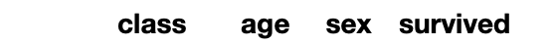
How to create a Random Forest
Original Dataset
class | age | alone | sex | survived
1 | adult | no | male | yes
2 | child | no | female | yes
2 | adult | yes | male | no
3 | child | yes | male | no
Create a new dataset by choosing 4 observation at random from original dataset
We can pick same observation more than once to build this bootstrapped dataset

Slide 8
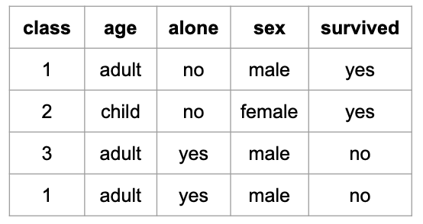
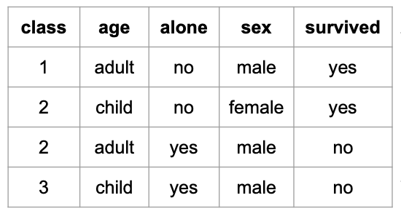
How to create a Random Forest
Original Dataset
Bootstrapped Dataset
class | age | alone | sex | survived
1 | adult | no | male | yes
2 | child | no | female | yes
2 | adult | yes | male | no
3 | child | yes | male | no
2nd sample
1st sample
3rd sample
4th sample

Slide 9
How to create a Random Forest
Bootstrapped Dataset
Step 2: Create a decision using the bootstrapped dataset and using random set of variables

Slide 10
How to create a Random Forest
Bootstrapped Dataset
Randomly select two variables as candidates for root node
age
????

Slide 11
How to create a Random Forest
Bootstrapped Dataset
Again randomly select two random variables as candidate for the next node
age
????
class
????

Slide 12
How to create a Random Forest
Bootstrapped Dataset
Again randomly select candidate for the next node
age
????
class
sex
????
????

Slide 13
How to create a Random Forest
Bootstrapped Dataset
Continue building the tree as usual but choosing random set of variables to choose from at each node
age
????
class
sex

Slide 14
How to create a Random Forest
Summarize: we built a decision tree:
Using bootstrapped data
Choosing a random subset of variables at each node
Bootstrapped Dataset
age
????
class
sex

Slide 15
How to create a Random Forest
Now go back to step 1 and repeat: Make a new bootstrapped dataset and choose a random set of variables at each node to create new tree.

Slide 16
How to create a Random Forest
You do this 100’s of times...but I have space only for 5 on this slide

Slide 17
How Random Forest work?
What does the first decision tree predict for an observation?
Make Prediction for this observation
??
Survived | Not Survived
1 | 0
The first tree says, the passenger ‘survived’

Slide 18
How Random Forest work?
What does the second decision tree predict for an observation?
Make Prediction for this observation
??
Survived | Not Survived
2 | 0
The second tree also says, the passenger ‘survived’

Slide 19
How Random Forest work?
After running the observation through all the trees, we see which option/label received the most votes
Make Prediction for this observation
Bootstrapping the data plus aggregating the results to make a decision is called bagging
??
Survived | Not Survived
4 | 1
Choose ‘survived’ as the final prediction

